Slide 1
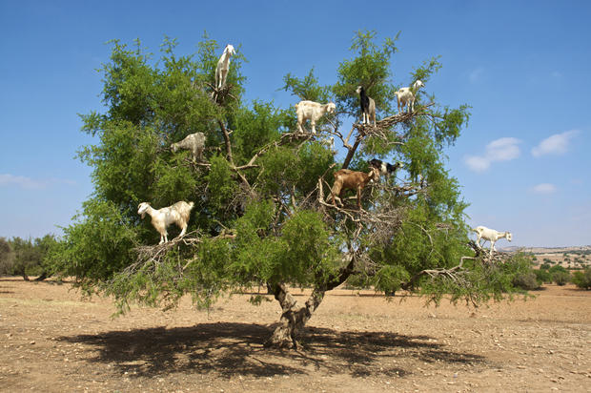
How have the goats got up the tree? They must have/ can’t have…..

Slide 2
Aim of the task:
To be able to do part 2 speaking exam, making guesses about past events

Slide 3
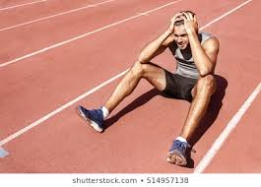
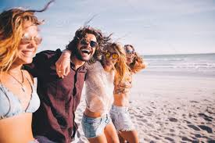
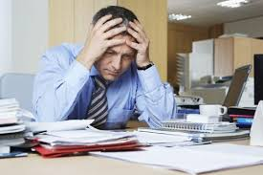
How might the people be feeling?
What might have caused them to feel like this?

Slide 4
(Play audio: ‘Part 2 Deductions with Native Speaker’)
AS YOU LISTEN:
Which photos does she compare?
What does she suggest caused them to feel this way?

Slide 5
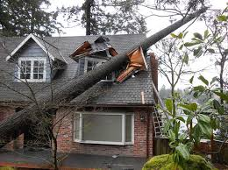
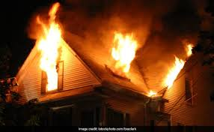
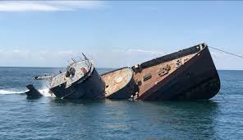
What might have caused
these disasters?
How might they have been
prevented?

Slide 6
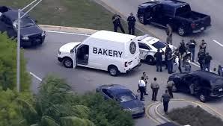
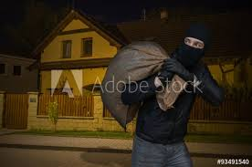
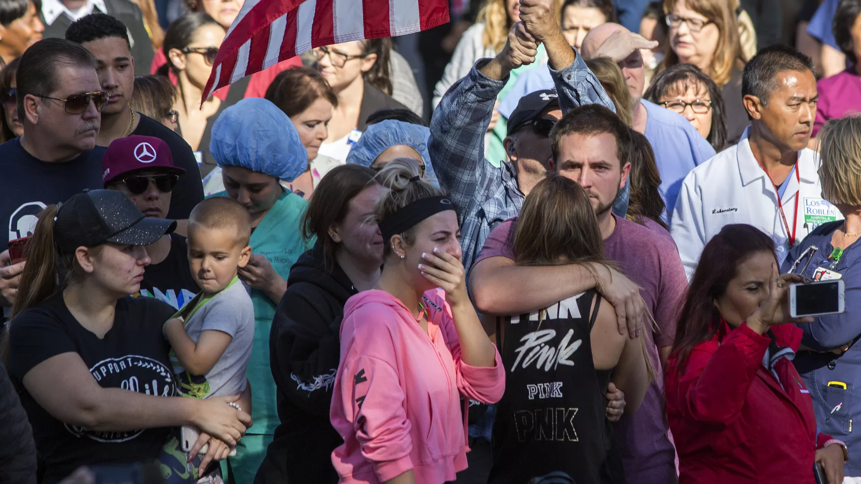
What crimes have
happened?
What effect have the
crimes had do you think?

